Slide 1
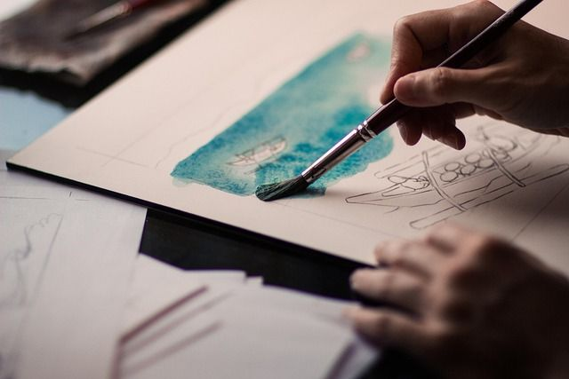
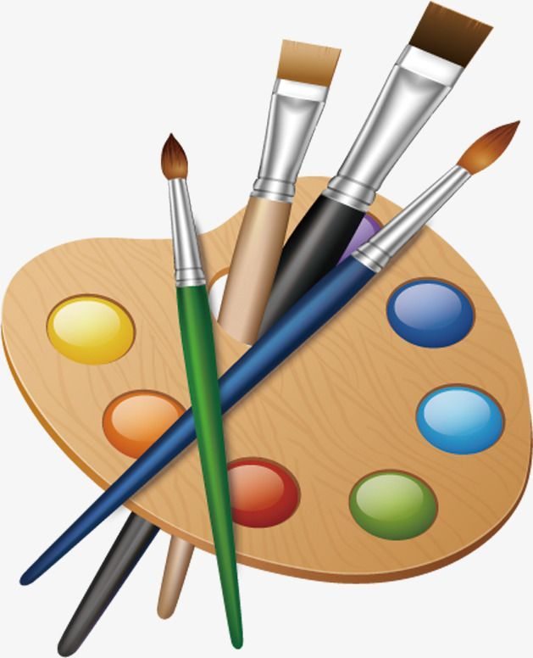
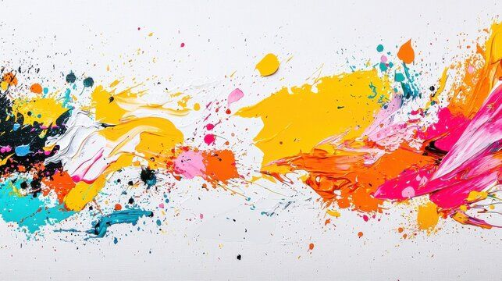
AI VIRTUAL PAINTER
GAURIKA AGARWAL
E23CSEU0369
B-13

Slide 2


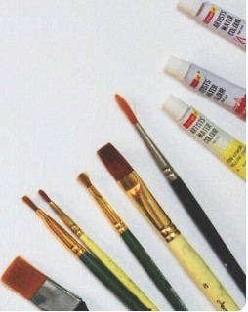
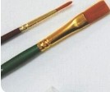
Al Virtual Painter
A Smart Vision-Based Virtual Drawing System
Project Title:The core concept behind the proj ect, 'A l
Virtual Painter,' focuses on utilizing artificial intelligence
techniques to create an interactive painting experience.
Subtitle:This project emphasizes a vision-based response system that offers a futuristic drawing environment
enabling users to create artwork without traditional tools.
Author & Institution: The presentation will showcase contr ibutions from the author,affiliated institution, and potential branding through a logo, alongside the date to contextua lize the information.
Background: An artistically designed or techno logy­ themed background sets a fitting tone for the innovative nature of this virtual painting project, enhancing audience engagement.

Slide 3
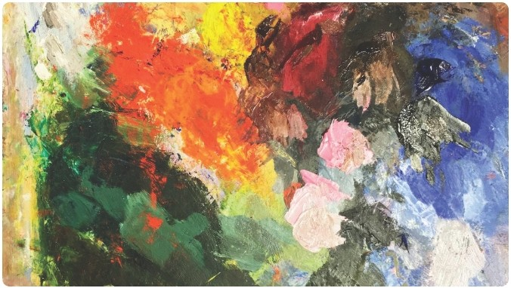
Introduction
Definition of Al Virtual Painter:The Al Virtual Painter is an interactive drawing system that leverages computer vision to allow users to create digital art dynam ically using movements detected through a webcam.
User Interaction via Webcam:Offer ing a seamless user experience, the system captures the user's movements in real­ time,translating hand gestures into artistic strokes, promoting access ibility and creativity.
Fun and Educational Project:This project aims to provide an engaging platform for users of varying skill levels, fostering creat ivity wh ile also serving educational purposes in art and technology integration.
Tech Stack: The project employs a robust technological foundat ion including Python for backend functionality, OpenCV for computer vision capabilities, MediaPipe for hand tracking,and NumPy for numerical computat ions.

Slide 4
Features & Technologies Used
Real-time Hand Tracking:Utilizing advanced algorithms, the system captures and interprets hand movements instantly, allowing for a fluid and responsive interactive drawing experience.
Virtual Brush & Eraser: The user can switch between various brush types and erasers, providing the flexibility to create intricate designs or erase mistakes seamlessly in a digital environment.
Color Palette SWitching:The implementation of an intuitive color selection tool allows users to choose from a diverse range of colors, enhancing creative possibilities in their artwork.
Smooth and Lag-free Drawing:Engineered for high performance,the system ensures that users experience minimal latency, making the digital drawing experience as organic as traditional methods.
Technologies: OpenCV powers the computer vision aspects, MediaPipe enables hand detection, NumPy handles numerical data effectively, and Python serves as the versatile programming language driving the overall application.

Slide 5
Working & Implementation
Capture Video Using Webcam:The initial stage involves activating the webcam to stream video,which provides the input necessary for detecting user movements and interactions.
Detect Hand Using MediaPipe:Through the MediaPipe framework ,the system processes the video feed to identify and localize the user's hand movements accurately.
Track Finger Tip for Cursor Simulation:By focusing on the tip of the user's fingers,the system simulates an interactive cursor that provides direct control over the virtual canvas, translating gestures into painting actions.
Draw Lines on Virtual Canvas:Once hand movements are recognized, the corresponding lines or strokes are rendered on a digital canvas,allowing for real-time creative expression.
Finger Gestures for Mode Charnges:Users can utilize various finger gestures to switch between different operating modes,such as erasing or selecting colors, enhancing interaction intuitiveness .
Include Flowchart or Diagram:Visual diagrams are essential in illustrating the architecture and workflow of the Al Virtual Painter, providing audiences with a comprehensive understanding of the implementation strategy.

Slide 6
Applications & Novelty
,,
Applications
The system finds utility in virtual whiteboards for collaborative work, interactive art installations, gesture-based user interfaces, and as a digital learning tool for creative education.
••
Novelty
Its unique aspects include the absence of external hardware for users, offering a real-time interaction experience that promotes a hands-free, accessible way of drawing and expressing oneself.

Slide 7
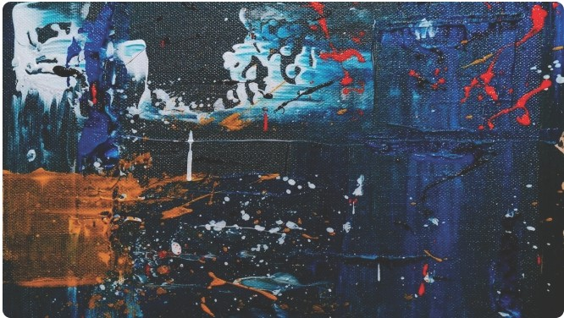
Conclusion & Future Scope
Summary of Project Success:Highlighting the successful combination of technology and art, the proj ect has demonstrated the feasibility of Al­ driven creativity in an interactive format.
Potential Improvements: Looking forward, enhancements such as multi-hand interaction, advanced shape recognition, and automatic saving features will significantly expand functionality and usability.
Conclude:Gesture-Based Al Applications:The proj ect's journey exemplifies the promising future of gesture-based Al applications,inspiring further innovative approaches in both art and education fields.

Slide 8
THANK YOU

